Slide 1
A compact method for smart-phone Camera Calibration
Kai zhang
School of remote sensing and information engineering
Wuhan university

Slide 2
abstract
This paper adopts a new camera calibration method to calibrate smartphone camera. The chessboard image is used as a control plane and the corners are defined as control points. This camera calibration method is compact and fast without any professional instruments. It could be implemented by non-professional users. The experiment result demonstrates that the average error is less than 0.1 mm. Therefore, it is possible to use smartphone camera in some applications which need not high accuracy.
Notes:
随着手机相机工艺的发展，手机相机的拍照效果越来越好，且价格越来越低。因此，在一些对精度要求不高的应用中，使用手机相机来代替昂贵的数码相机成为可能。手机具有以下两个优点，价格低廉并且效果也不差。在进行量测之前，都要进行相机检校，使用传统的检校场不太现实，因此，简单易用的相机检校方法成为需要。目标：简单，易用，成本低，精度高。

Slide 3
introduction
What is camera calibration?
The process of finding the camera parameters when imaging.
It stands for the relationship between the 3-D geometric coordinates of a point and its corresponding coordinates in image.

Slide 4
Calibration methods
According to the used calibration object, the methods for camera calibration are sorted as [1]:
1 stereo calibration method
2 plane calibration method
3 line calibration method
4 self-calibration method

Slide 5
1、Stereo calibration method
Observe a calibration object whose geometry in 3-D space is known with very good precision.[2]
Advantages:
Adaptive to any camera model
High precision
Disadvantage:
Specific calibration apparatus.
Complex.

Slide 6
2、Plane calibration method
Require to observe a planar pattern shown at a few diﬀerent orientations.[3]
Advantage:
Flexible and robust.
Less cost.
Disadvantage:
(1) Not conducive to automated calibration.

Slide 7
3、Line calibration method
Observe objects consisting of three or more colinear points with known relative positioning.[4]
Advantage:
Could calibrate the multiple cameras.
Disadvantage:
The fixed point should be seen by all cameras.

Slide 8
4、Self-calibration method
Calibrate camera by image point correspondence.[5]
Advantage:
(1)No need reference objects.
(2)Adaptive to condition when intrinsic parameters are not fixed
Disadvantage:
(1)Less precision.
(2)Complex.

Slide 9
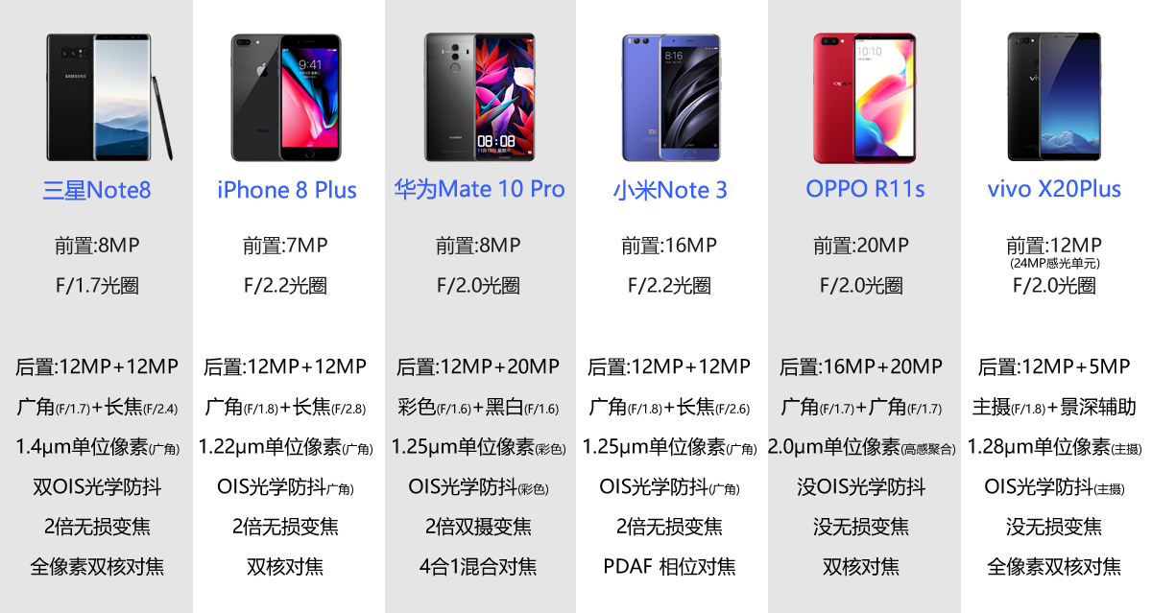
Smartphone camera
Nowadays, smartphone camera could also have good performance on imaging.
Following is the comparison on camera of several smartphones.

Slide 10
methodology
We adopt the plane calibration method to calibrate smartphone camera.
We apply bundle adjustment by additional parameters to calculate interior parameters and exterior parameters.

Slide 11
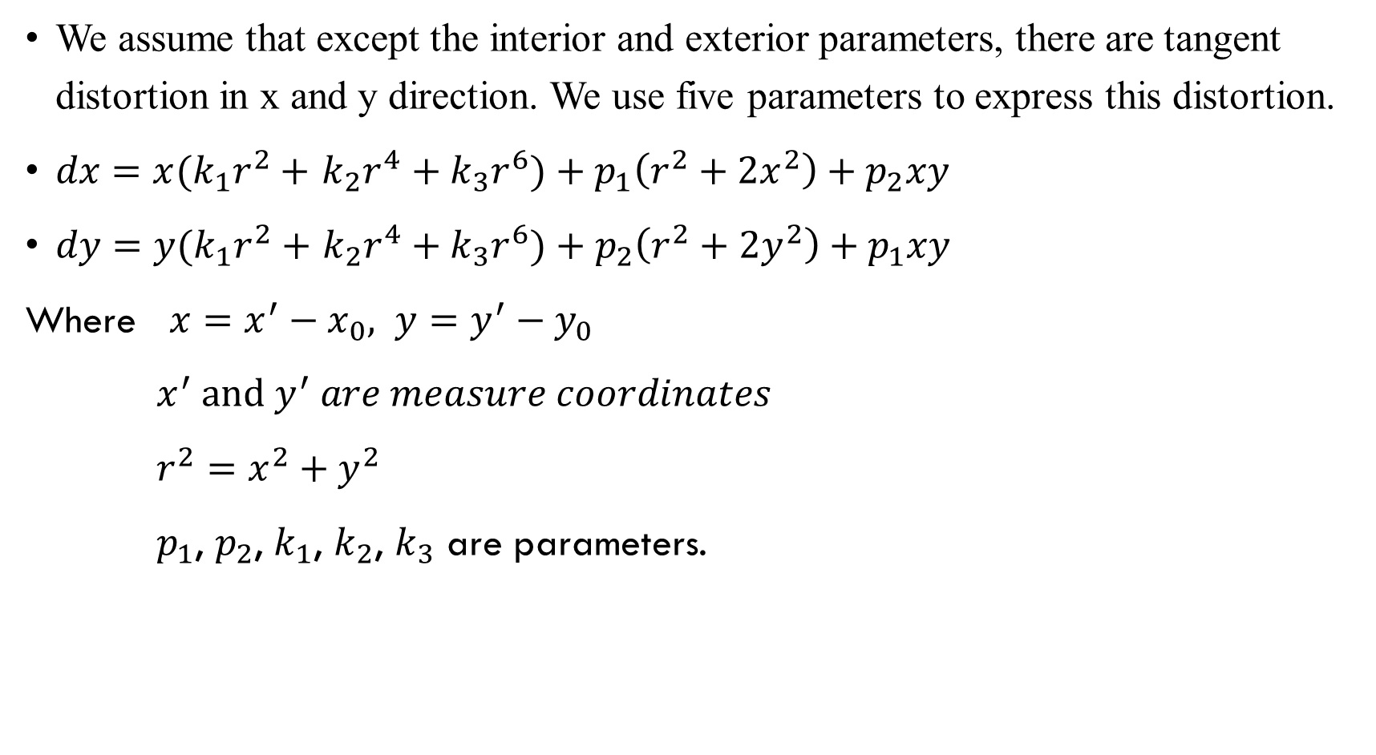
We assume that except the interior and exterior parameters, there are tangent distortion in x and y direction. We use five parameters to express this distortion.
$dx=x(k_{1}r^{2}+$ $k_{2}r^{4}+k_{3}r^{6})+p_{1}\left(r^{2}+2x^{2}\right)+p_{2}xy$
$dy=y(k_{1}r^{2}+$ $k_{2}r^{4}+k_{3}r^{6})+p_{2}\left(r^{2}+2y^{2}\right)+p_{1}xy$
Where $x=x^{′}−x_{0}, y=y^{′}−y_{0}$
$x^{′} and{ y}^{′} are measure coordinates$
${r^{2}=x}^{2}+y^{2}$
$p_{1}$, $p_{2}$, $k_{1}$, $k_{2}$, $k_{3}$ are parameters.

Slide 12
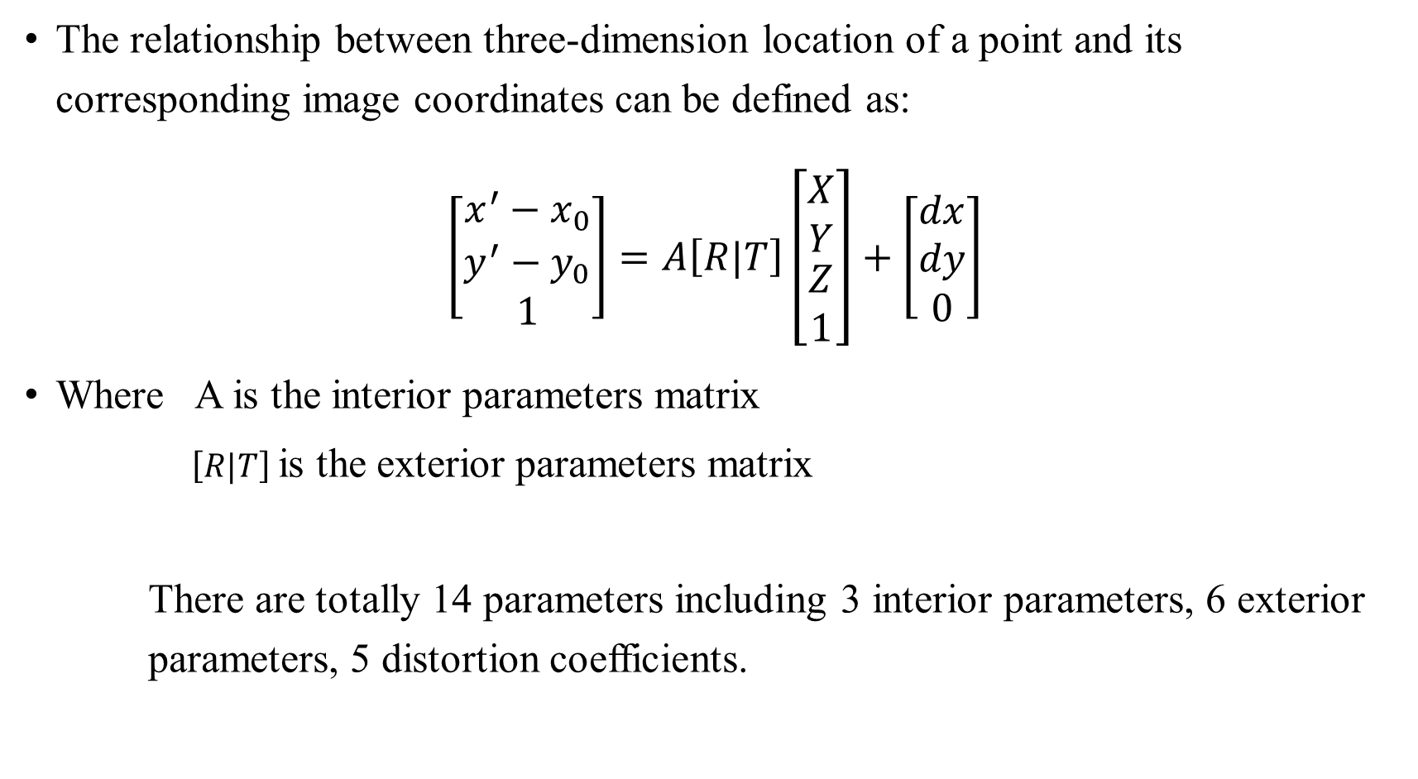
The relationship between three-dimension location of a point and its corresponding image coordinates can be defined as:
$$\left[\begin{matrix}x^{′}−x_{0} \\ y^{′}−y_{0} \\ 1\end{matrix}\right]=A\left[R|T\right]\left[\begin{matrix}\begin{aligned}X \\ Y\end{aligned} \\ \begin{aligned}Z \\ 1\end{aligned}\end{matrix}\right]+\left[\begin{matrix}dx \\ dy \\ 0\end{matrix}\right]$$
Where A is the interior parameters matrix
$\left[R|T\right]$is the exterior parameters matrix
There are totally 14 parameters including 3 interior parameters, 6 exterior parameters, 5 distortion coefficients.

Slide 13
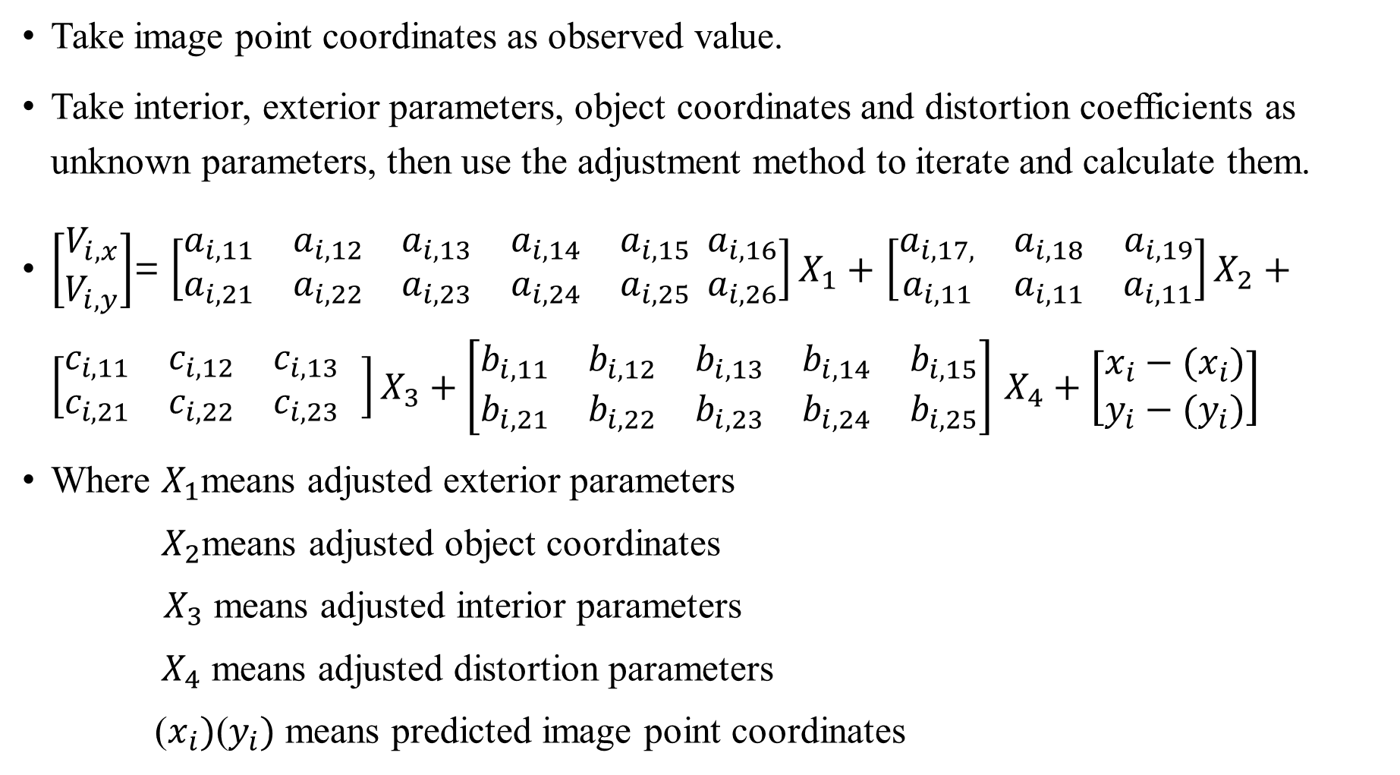
Take image point coordinates as observed value.
Take interior, exterior parameters, object coordinates and distortion coefficients as unknown parameters, then use the adjustment method to iterate and calculate them.
$\left[\begin{matrix}V_{i,x} \\ V_{i,y}\end{matrix}\right]$= $\left[\begin{matrix}a_{i,11} & a_{i,12} & a_{i,13} & a_{i,14} & a_{i,15} \\ a_{i,21} & a_{i,22} & a_{i,23} & a_{i,24} & a_{i,25}\end{matrix} \begin{matrix}a_{i,16} \\ a_{i,26}\end{matrix}\right]X_{1}+$ $\left[\begin{matrix}a_{i,17,} & a_{i,18} & a_{i,19} \\ a_{i,11} & a_{i,11} & a_{i,11}\end{matrix}\right]X_{2}+\left[\begin{matrix}c_{i,11} & c_{i,12} & c_{i,13} \\ c_{i,21} & c_{i,22} & c_{i,23}\end{matrix} \right]X_{3}+\left[\begin{matrix}b_{i,11} & b_{i,12} & b_{i,13} & b_{i,14} & b_{i,15} \\ b_{i,21} & b_{i,22} & b_{i,23} & b_{i,24} & b_{i,25}\end{matrix}\right]$ $X_{4}+\left[\begin{matrix}x_{i}−{(x}_{i}) \\ y_{i}−{(y}_{i})\end{matrix}\right]$
Where $X_{1}$means adjusted exterior parameters
$X_{2}$means adjusted object coordinates
$X_{3}$ means adjusted interior parameters
$X_{4}$ means adjusted distortion parameters
($x_{i})\text{(}y_{i})$ means predicted image point coordinates

Slide 14
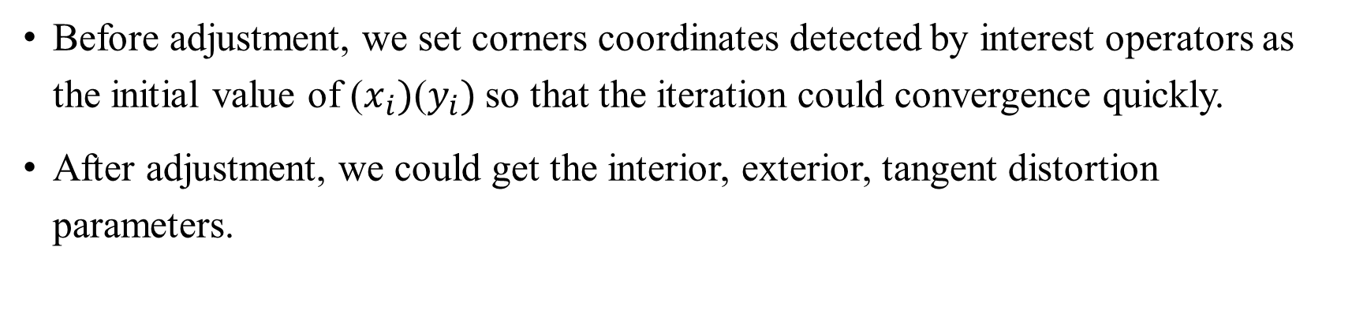
Before adjustment, we set corners coordinates detected by interest operators as the initial value of ($x_{i})\text{(}y_{i})$so that the iteration could convergence quickly.
After adjustment, we could get the interior, exterior, tangent distortion parameters.

Slide 15
Experiment and result
We use the smartphone to take six photos from different viewpoints. These images have affine transformation relationship.
Experiment details:
(1)The chessboard gridwidth = gridheight=14mm
(2)Smartphone : HUAWEI Honor 6 plus

Slide 16
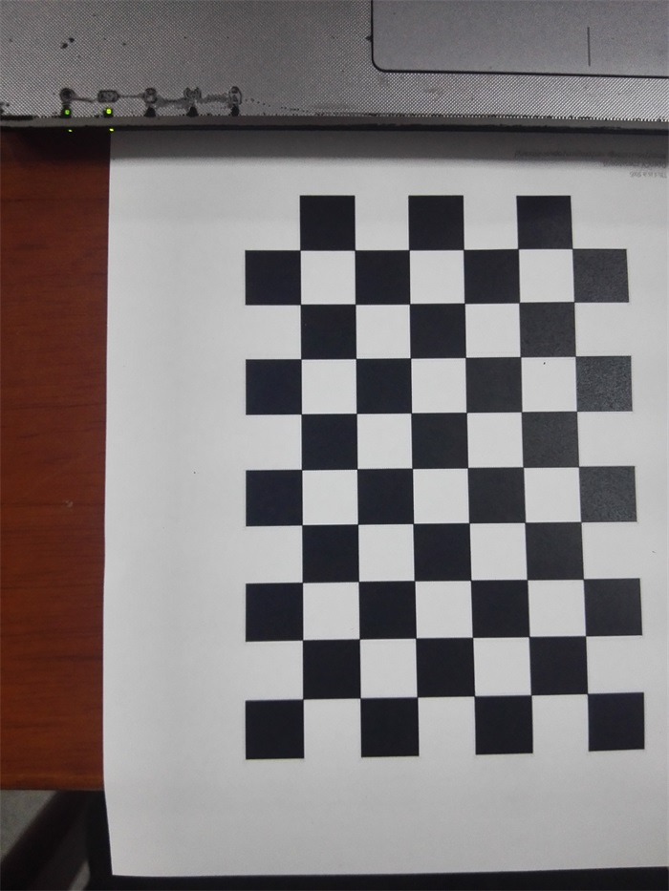
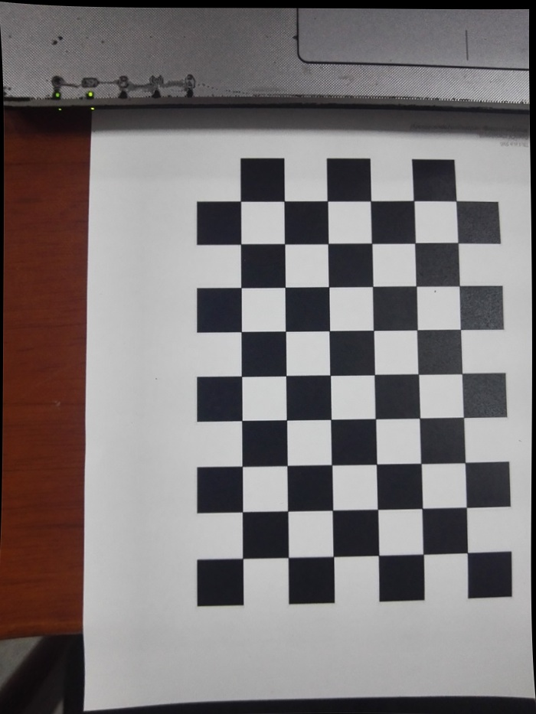
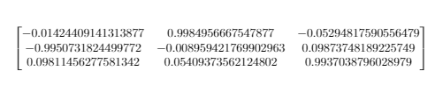

Image 1 Result
rotation matrix:
translation vector:
average error is 0.0739896mm

Slide 17
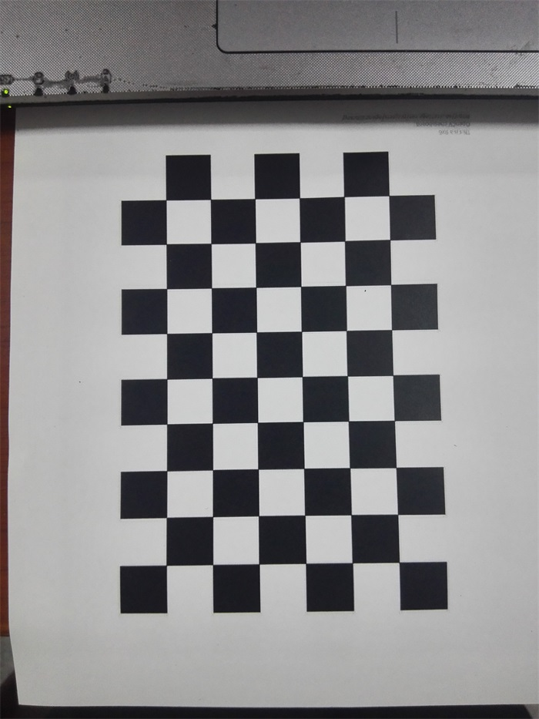
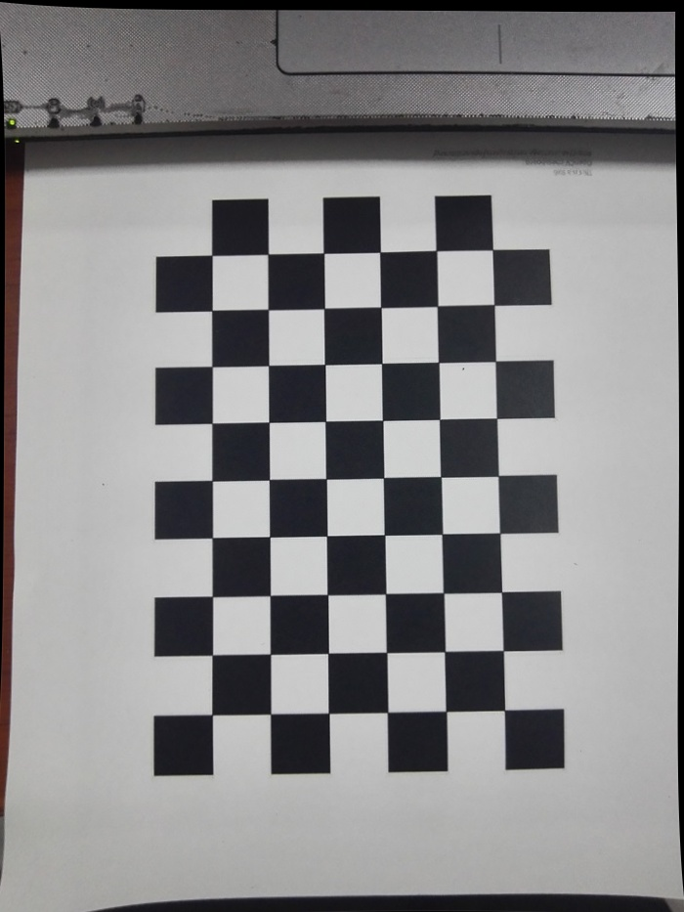

Image 2 Result
rotation matrix:
translation vector:
average error is 0.0643934mm

Slide 18
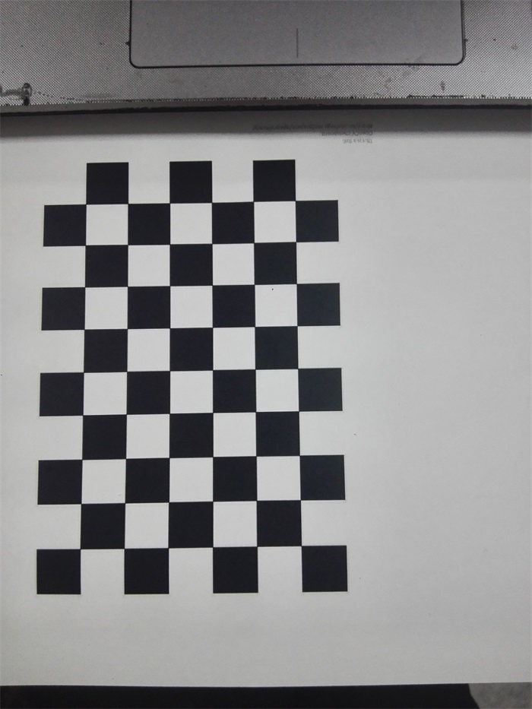
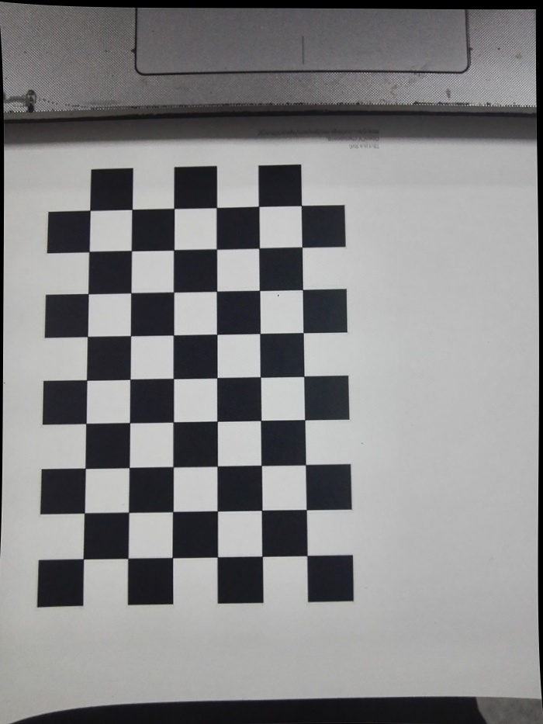

Image 3 Result
rotation matrix:
translation vector:
average error is 0.0649147

Slide 19
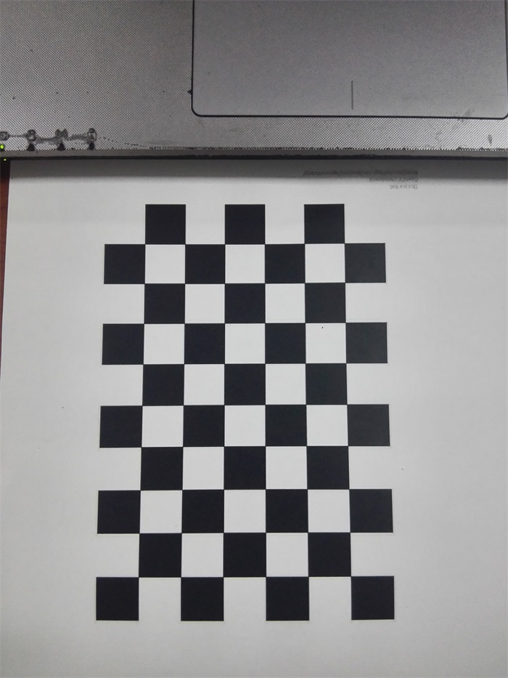
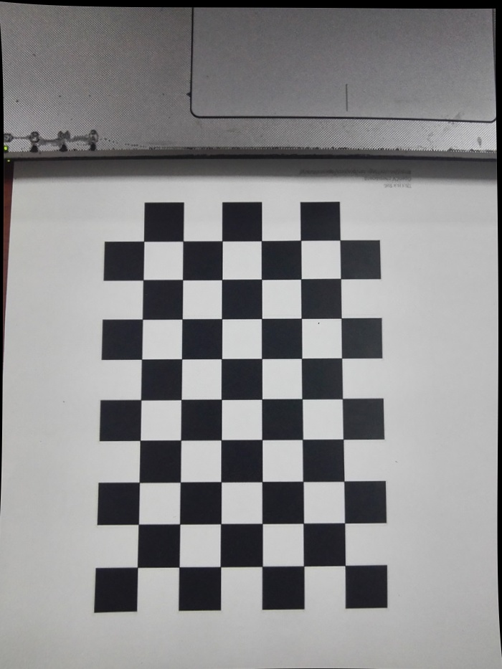

Image 4 Result
rotation matrix:
translation vector:
average error is 0.070202mm

Slide 20
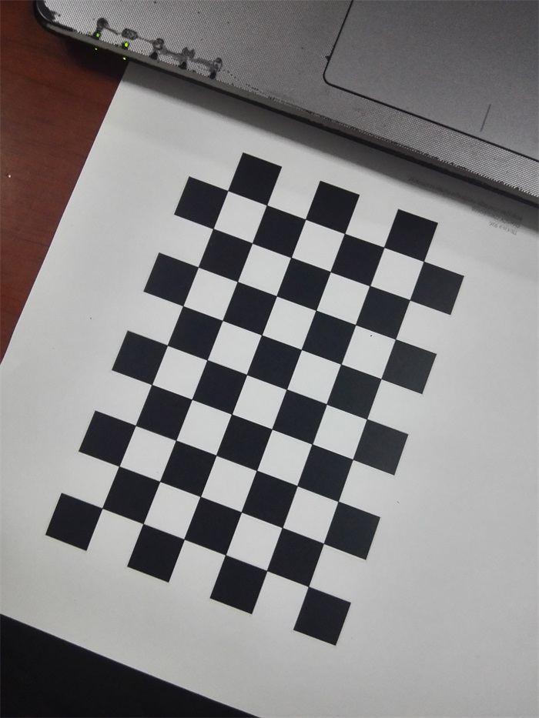
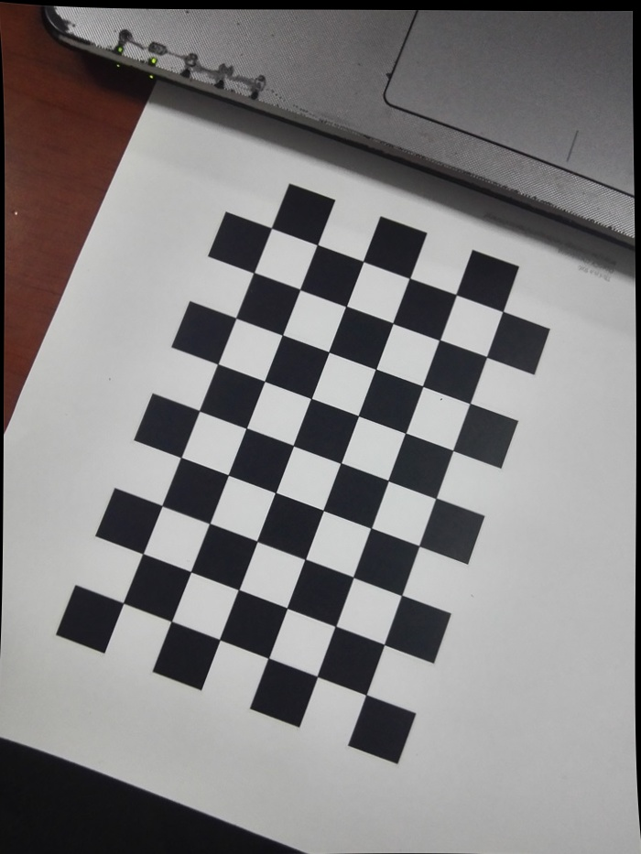

Image 5 Result
rotation matrix:
translation vector:
average error is 0.0543511mm

Slide 21
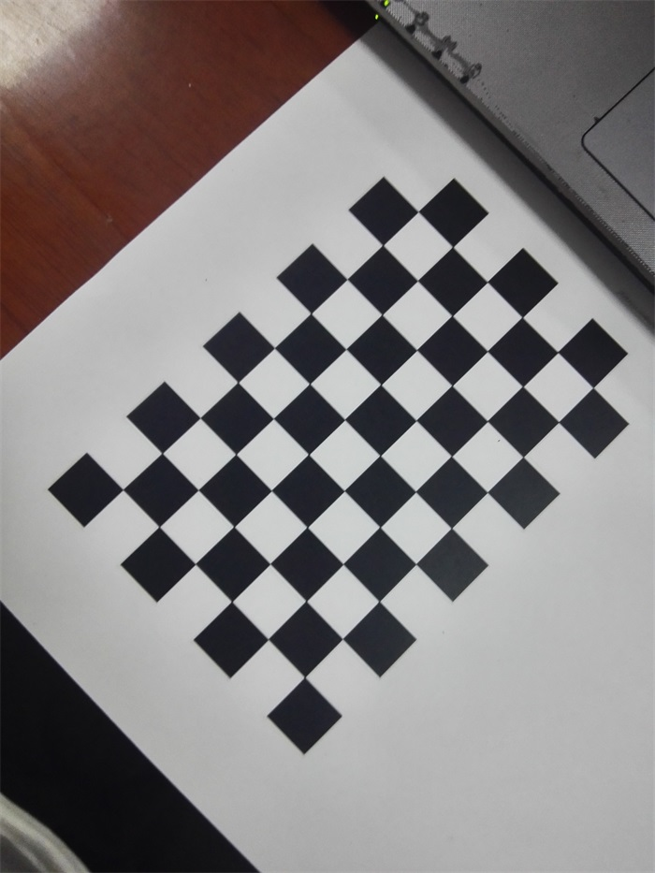
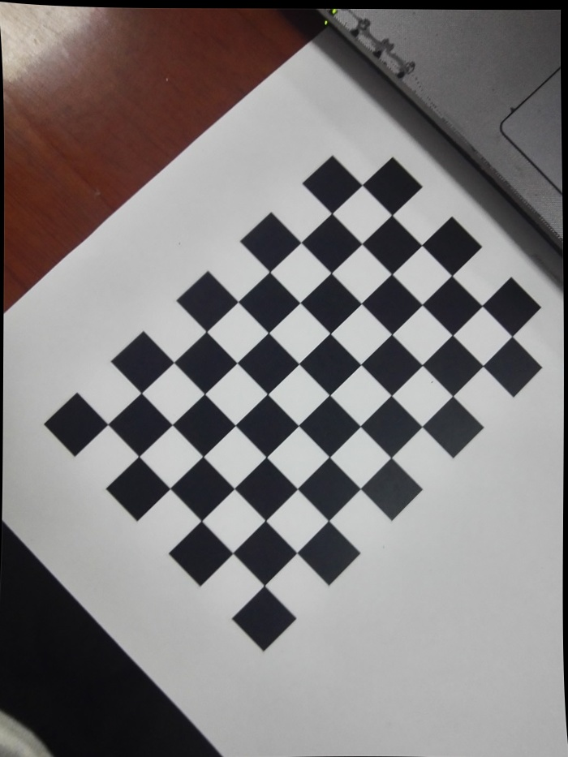

Image 6 Result
rotation matrix:
translation vector:
average error is 0.114672mm

Slide 22

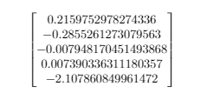
intrinsic matrix:
distortion coefficients

Slide 23
conclusion
This paper adopt a plane calibration method to calibrate smartphone camera.
this method has following advantages:
(1) calibration with high accuracy.
(2) flexibility and robust.
(3) with less cost.

Slide 24
reference
[1]Wang H, Shen S, Lu X. Comparison of the camera calibration between photogrammetry and computer vision[C]// International Conference on System Science and Engineering. IEEE, 2012:358-362.
[2]Qi W, Li F, Liu Z. Review on camera calibration[C]// Chinese Control and Decision Conference. 2010:3354-3358.
[3]Zhang Z. A flexible new technique for camera calibration[J]. Tpami, 2000, 22(11):1330-1334.
[4]Zhang Z. Camera calibration with one-dimensional objects[C]// European Conference on Computer Vision. Springer Berlin Heidelberg, 2002:161-174.
[5]Ma S D. A self-calibration technique for active vision systems[J]. IEEE Trans Robotics Automat, 1996, 12(1):114-120.

